Slide 1
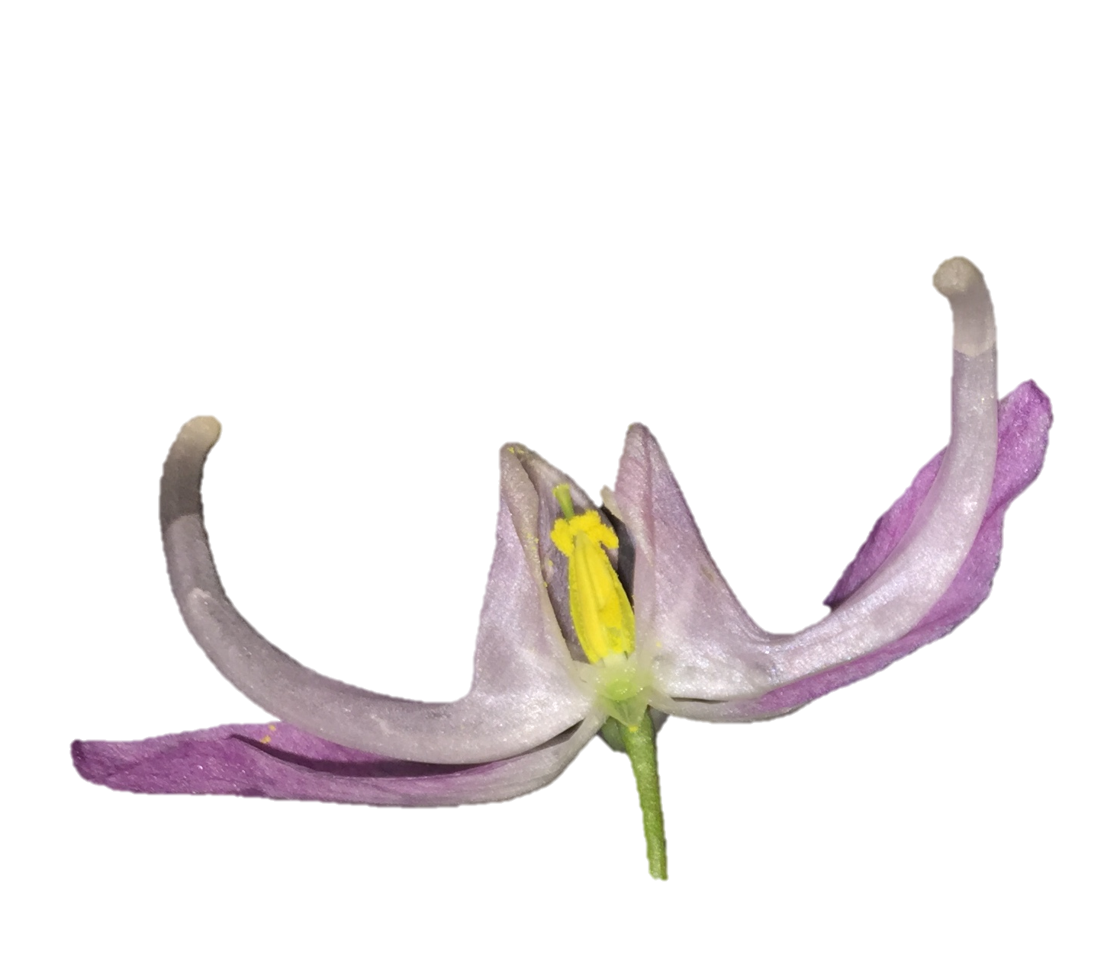
arc length
orthogonal length
chord length
chord length
ϴ
R

Slide 2
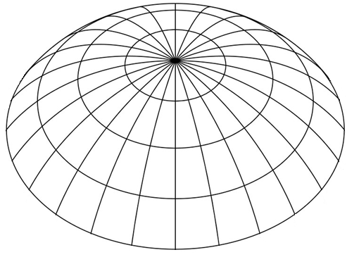

1.
2.
PC2
3.
PC1
Notes:
Landmarks and semi-landmarks are assigned to a specimen with each point having an (xy) coordinate.
For each specimen, a configuration of landmarks exists as a single point in a non-Euclidian shape space (abstracted here as a simple sphere). Red points represent landmark configurations from other specimens.
Shape data is projected onto a Euclidian plane – a tangent space approximation. This allows statistical analyses of shape variation (e.g. principal components analysis).

Slide 3
1.
2.
y = ax^n + bx^n-1 + … + c
3.
T₁
T₁
T₂
T₂
ф
Notes:
Figure 3

Slide 4
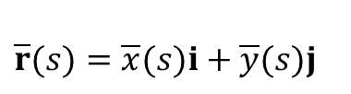
y
y
$\overline{r}(s)=\overline{x}(s)i+\overline{y}(s)j$
s = 4
s = 6
P= (2, 1)
s = 1
{
r
j
{
x
x
i
Notes:
Figure 4. Illustrations of vectors. Left: On the x and y axis are the unit vectors i and j, respectively, of length 1. The point P = (2,1) can be rewritten as a position vector r, that is made of two i unit vectors and one j unit vector, r = 2i + j. The length of r is ||r|| = sqrt 2^2+1^2. Right: A vector valued function describing a curve, parameterized by arc length.

Slide 5
ϴ₁
ϴ₂
R
ϴ₁ = 90 - ϴ₂
2ϴ₁ = 180 - 2ϴ₂
2ϴ₁ = 180 - ϴ₂ - ϴ₃
2ϴ₁ = ϴ₄
ϴ₁ = ϴ₄ / 2
sin ϴ₄ / 2 = (C / 2) / R
sin ϴ₁ = (C / 2) / R
R = (C / 2) / sin ϴ₁
C
ϴ₄
ϴ₃

Slide 6
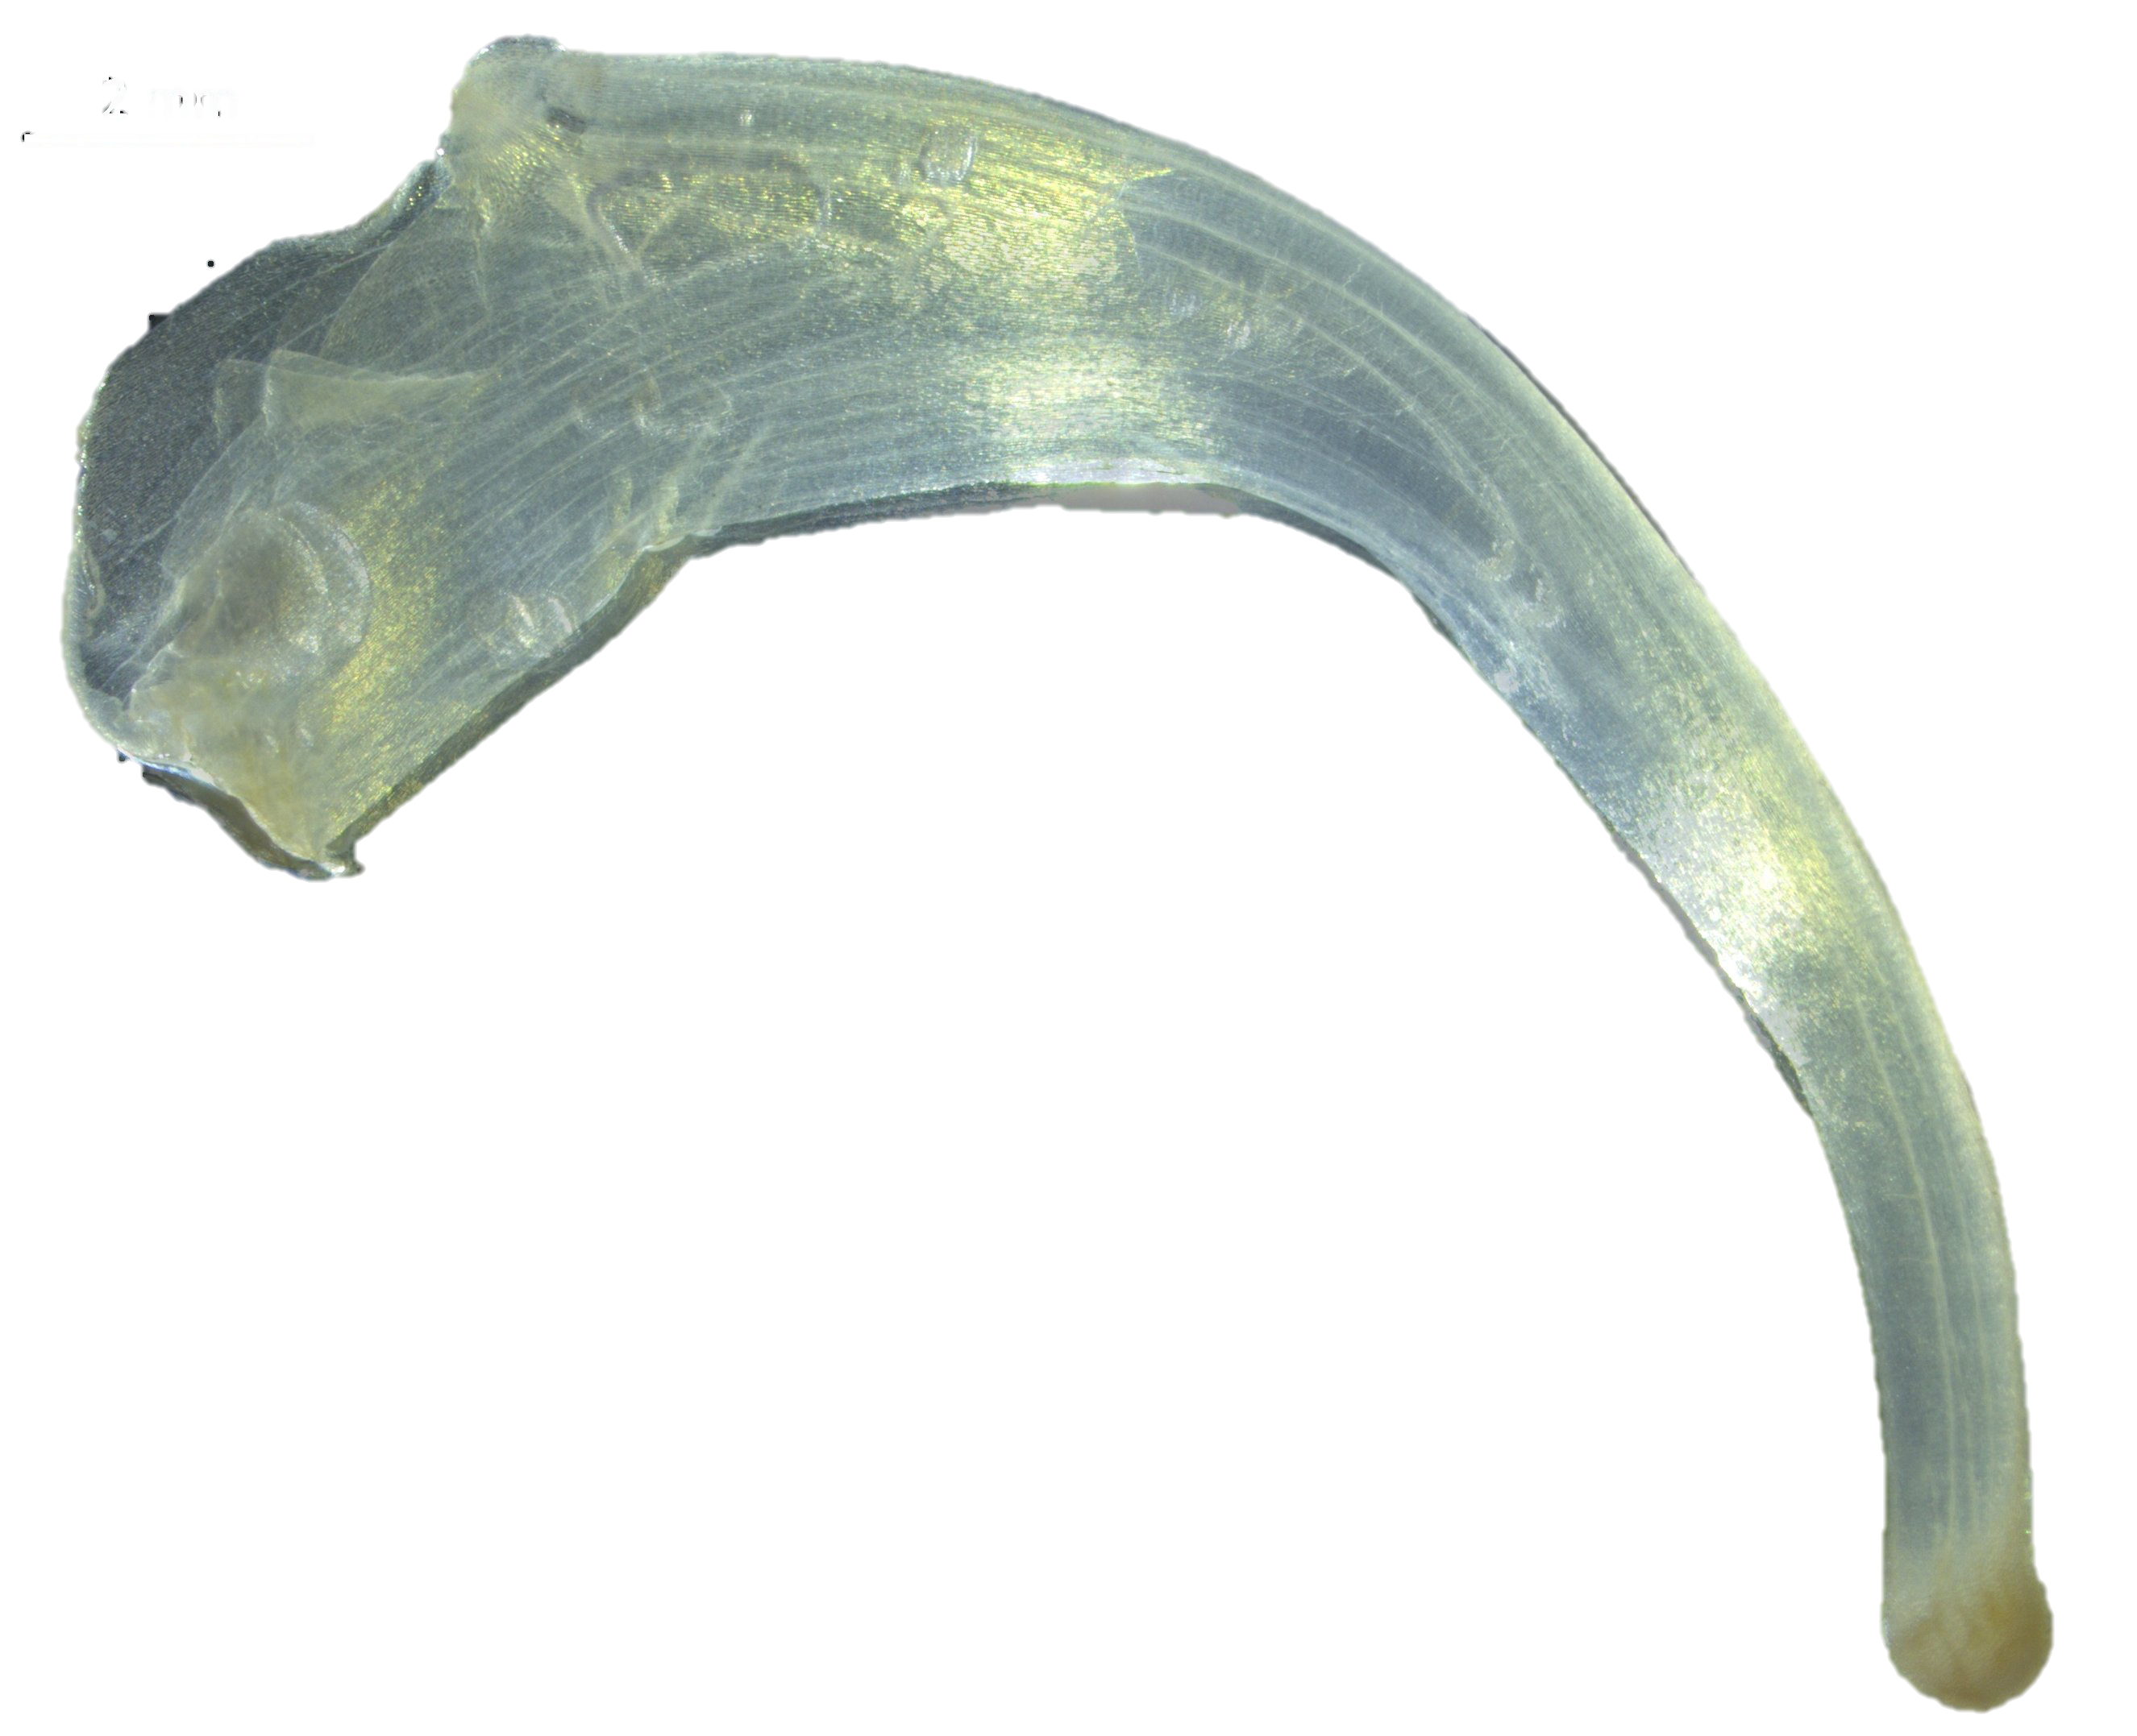
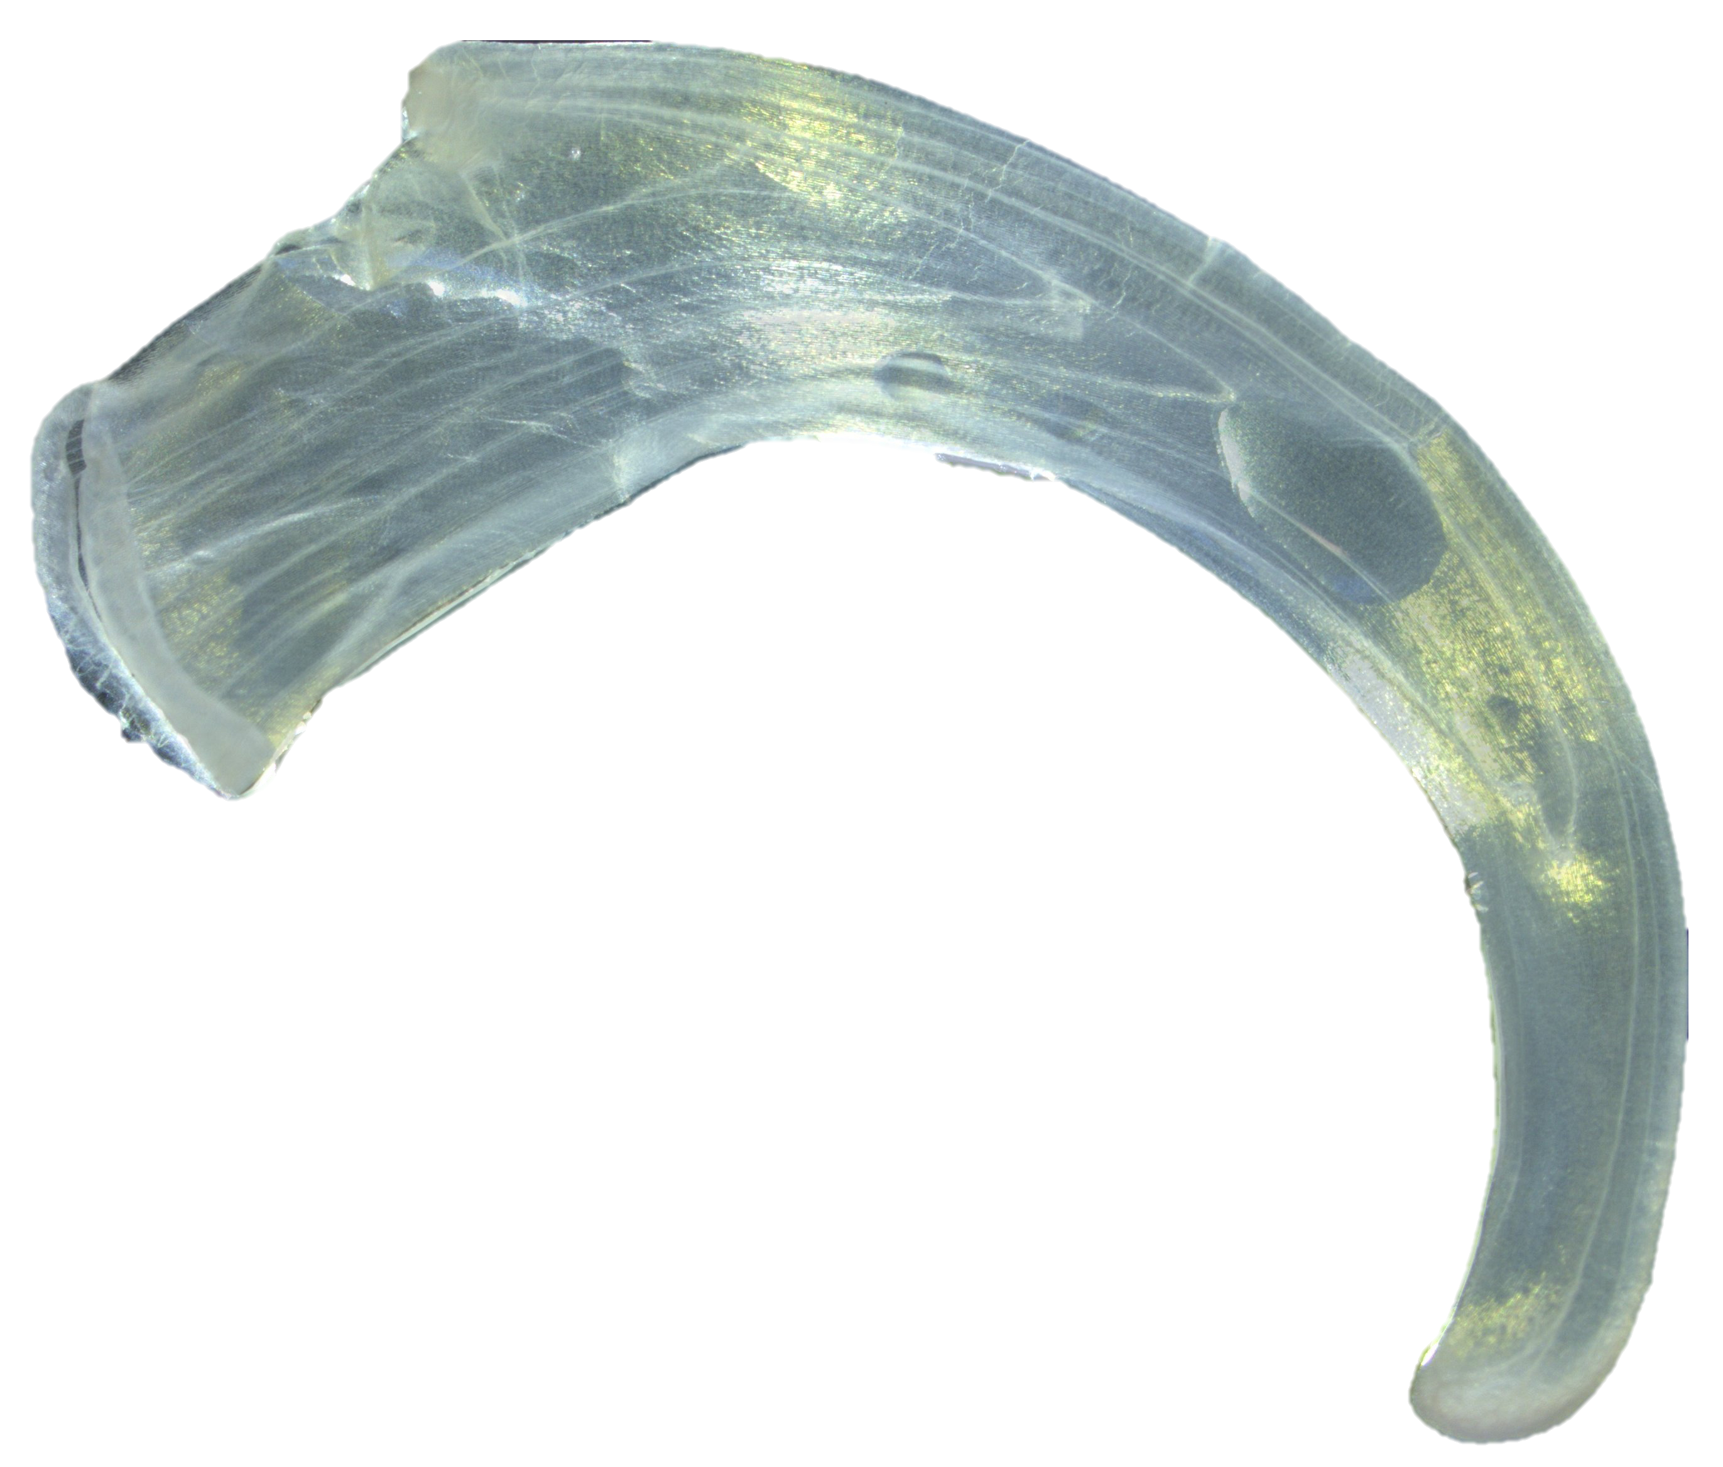
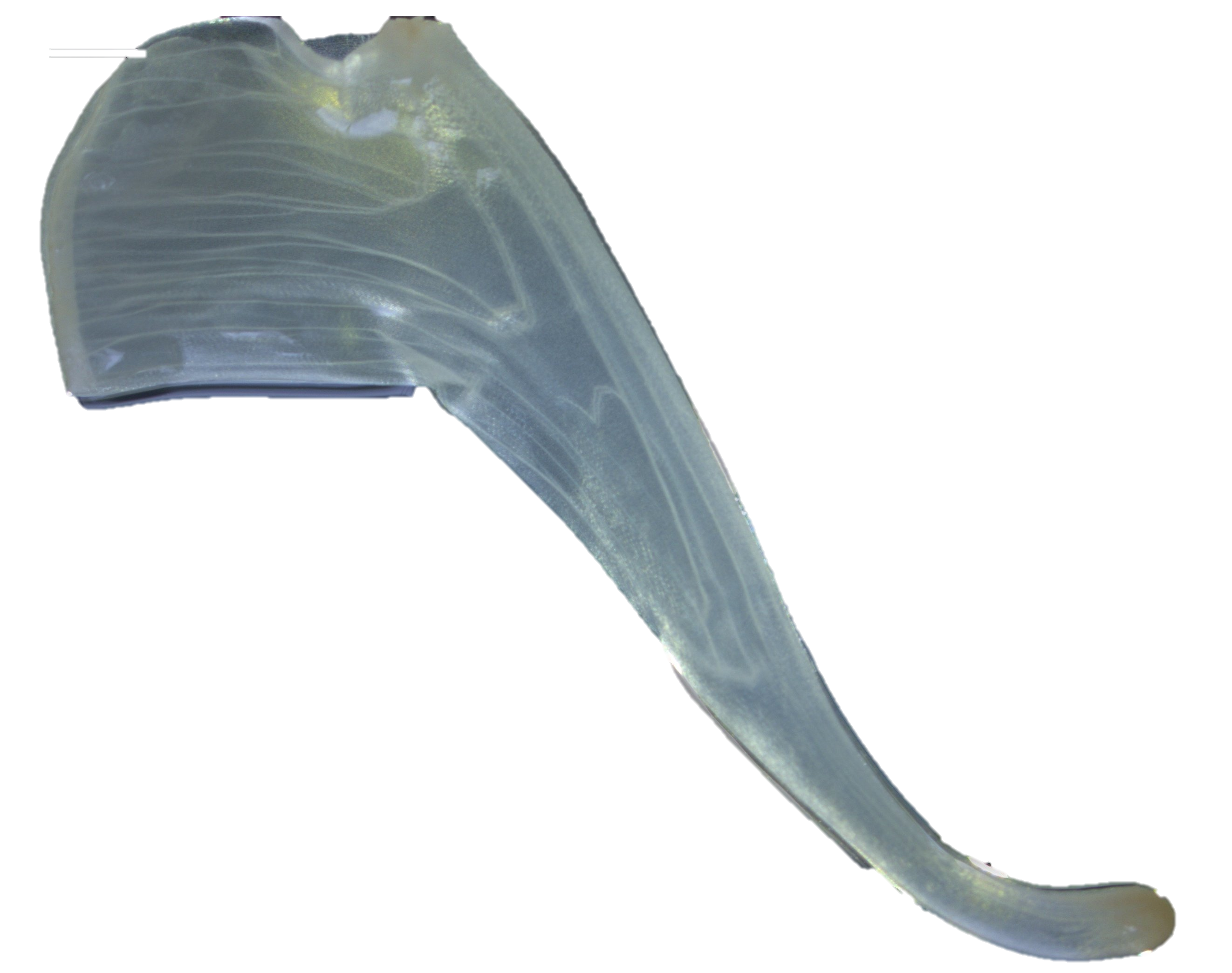
2.
1.
3.
Notes:
Homologous landmarks placed for Epimedium violaceum (1), Epimedium koreanum (2), and Epimedium grandiflorum (3). Thirteen equidistant semi-landmarks were placed between the two landmarks making 15 landmarks total.

